Slide 1

Introduction to
Translation and Interpreting

Slide 2
About me
What is the
[Translator/Interpreter]
[Languages]
[Specializations]
[Fun facts/favorite part of your career]
Notes:
Personalize this slide by adding your details in between the red brackets, and then deleting the brackets.

Slide 3
About the American Translators Association (ATA)
What is the
National not-for-profit association with an international orientation
Largest professional association of
language professionals in the United States
Notes:
ABOUT ATA

Slide 4
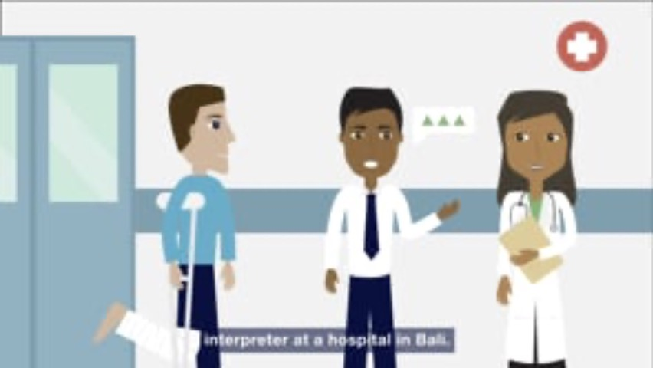
A Day in the Life…
Mission Statement
Notes:
A Day in the Life of Translators and Interpreters
ATA invites you to see how translators and interpreters work in this short, animated video!
If you have internet access, you can play this embedded video. You can also view this video using this link: https://www.atanet.org/video/a-day-in-the-life-of-translators-and-interpreters/
If you do not have internet access, you can download this video to play during your presentation using this link: https://vimeo.com/americantranslators/download/418207914/703357f815

Slide 5
Can you tell me…
What’s the difference between a translator and an interpreter?

Slide 6
What is the difference between translators and interpreters?

Slide 7
Translators work from their second language into their native language.
For example, I’m [an X to Y translator].
What language would you translate into?
Notes:
Personalize this slide by adding your details in between the red brackets, and then deleting the brackets.

Slide 8
Interpreters work in both directions.
For example, I interpret between [X and Y].
What languages would you interpret?
Notes:
Personalize this slide by adding your details in between the red brackets, and then deleting the brackets.

Slide 9

Have you ever…
Worked with or seen an interpreter before? (At the doctor’s office, in movies)
Read something that was
translated before?
(a book, subtitles on a film)

Slide 10
Did you know…
Before you become a translator or interpreter:
You must be bilingual.
  That means you need to speak, read, and write almost perfectly in more than one language.
Being bilingual isn’t enough.
Additional training is needed to become a professional interpreter or translator.

Slide 11



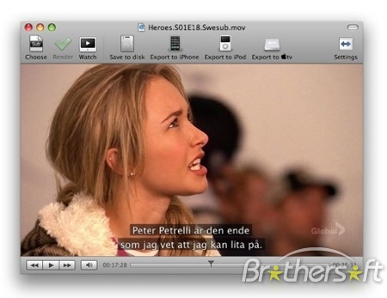


Common areas of work for translators and interpreters

Slide 12

Translation problems…
What happens if you work with an unprofessional translator or interpreter?
Some translation mistakes can be funny, and some can be very serious!

Slide 13
Who needs translators and interpreters?
Hospitals and clinics
Courts
International businesses
United Nations
Government (President, etc.)

Slide 14
Resources for students
Visit the ATA website for more information: www.atanet.org

Slide 15
Questions?
[Your contact information]
Notes:
Personalize this slide by adding your details in between the red brackets, and then deleting the brackets.

